Slide 1

Big Data Analytics
The Italian labor market:
a survey of regional dynamics and an analysis of Youth Employees and NEETs
Prof. Orazio Tomarchio

Slide 2
INTRODUCTION
BUSINESS QUESTIONS
DATASETS
DIMENSIONAL FACT MODEL
INDEX
ETL
DASHBOARDS
DATA STORY
ANALYSIS REPORT
COLOR BLIND TEST
CONCLUSION

Slide 3
INTRODUCTION
This report discusses the occupational status in Italy from 2005 to 2020.
The report focuses on the employment rate and unemployment rate by gender and in each region, with a focus on Sicily.
From this general analysis we move on to a more specific one dealing with Neets, that is, young people not working and not studying, and youth employment.
The approach used to calculate the various employment and unemployment rates is based on the total population aged 15 and over.
Some factors such as education and some economic indicators such as GDP, GDP per capita and domestic labor income are related to the two rates mentioned.

Slide 4
BUSINESS QUESTIONS
1)
a)
b)
c)
How has the trend of total employment and unemployment rate varied over the years in Italy?
How has the trend of female employment and unemployment rate varied over the years in Italy?
How has the trend of male employment and unemployment rate varied across over the years in Italy?
And what about Sicily?
2)
What is the trend of other occupational conditions such as inactive, not seeking and unwilling to work and gray area of inactivity?
3)
a)
b)
c)
What is the best region in terms of youth employment and with a lower rate of Neets?
What is the correlation between youth employment rate and Neets rate?
And what about Sicily?
What is the picture of the Italian regions, in terms of Neets and youth employment, in 2019, 2020 and before the 2008 crisis?

Slide 5
BUSINESS QUESTIONS
4)
a)
b)
What is the relationship between GDP and employment and unemployment rates of indifferent regions?
And what about Neets?
And what about youth employment?
5)
a)
b)
What is the relationship between education rate and employment and unemployment rate?
And what about Neets?
And what about youth employment?
6)
How can the situation of Neets and youth employment in Italy be improved?

Slide 6
DATASETS
Gross domestic product (GDP) | Per-capita values
This table presents the gross domestic product(GDP) at market prices for NUTS Level 2 regions in Italy, expressed in millions of Euros. This table is composed by 336 records. | In this table are values of GDP per capita and domestic labor income taken from the Eurostat website. Data are taken at market price for NUTS Level 2 regions in Italy, expressed in thousands of euros. This table is composed by 2688 records.
Population | Education
In this table are data by occupational status of the population aged 15 years and older. They are further divided by gender and by region precisely by NUTS Level 2 so as to get a clear picture. The data are expressed in thousands. This table is composed by 7056 records. | In this table there are data by education and by type of education in the population aged 15 years and older. They are further divided by gender and by region precisely by NUTS Level 2. The data are expressed in thousands. This table is composed by 6048 records.
Youth Employees | NEET
This table comes from the EUROSTAT website and contains the youth employment rate by region; it is divided by NUTS Level 2 in Italy. Again they are divided by gender and total. Values are expressed as percentages. This table is composed by 1008 records. | This table comes from the EUROSTAT website and contains the neet rate by region; the division is by NUTS Level 2 in Italy. Again they are divided by gender and total. Values are expressed as percentages. This table is composed by 1008 records.

Slide 7
DIMENSIONAL FACT MODEL
The Dimensional Fact Model is an ad hoc and graphical formalism specifically devised to support the conceptual modelling phase.
The conceptual representation generated by the DFM consists of:
A fact is a concept relevant to decision-making processes. It typically models a set of events taking place within a company. In our case, the fact is the ‘Labour markets’.
A measure is a numerical property of a fact and describes a quantitative attribute that is relevant to analysis. In our case, the labor market can be measured by the types of professional conditions and their rates.
A dimension is a property, with a finite domain, that describes an analysis coordinate of the fact. A fact generally has multiple dimensions that define its minimum representation granularity. The dimensions of the Labour market are the Year where the analyzed rates are recorded, the Economic Indicators rate of regions where the analyzed rates are recorded and the Education rate by region where the rates are analyzed and Regions.
A dimensional attribute is a property, with a finite domain, of a dimension. For example, economic indicators can be described by GDP, GDP per capita and domestic income.

Slide 8
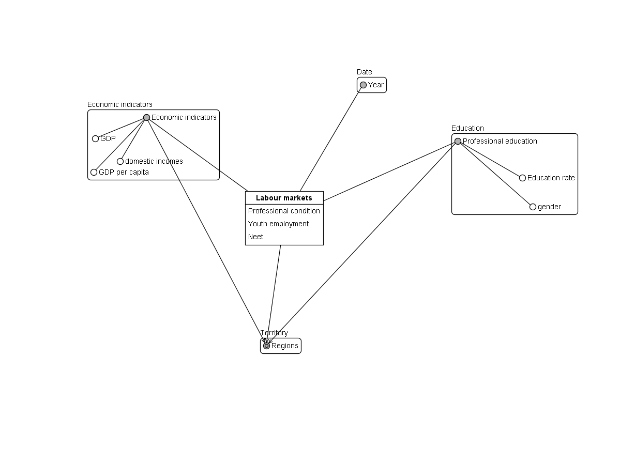
DIMENSIONAL FACT MODEL

Slide 9

ETL
In the world of data warehousing, ETL (Extract, Transform, Load) tools are essential for integrating data from multiple sources into a centralized database.
This process is crucial for generating business intelligence and managing data effectively.
ETL consists of three main steps:
Data Extraction: This is the initial step where data is gathered from various sources, such as data warehouses or data lakes, and consolidated into a single repository.
Data Transformation: In this phase, data quality and consistency are improved through various processes, including data cleansing, standardization, deduplication, verification, sorting, and other optional tasks. Data transformation is considered the most critical part of ETL as it ensures data integrity and compatibility.
Data Loading: The final step involves transferring the transformed data into a new destination, which could be a data warehouse or data lake. Loading can be done all at once (full load) or at scheduled intervals (incremental load). Full loading creates large datasets, while incremental loading is more manageable and efficient for maintaining business intelligence.
Our Transform phase can be summarized in four steps:
• Input
• Cleaning and Computing
• Joining
• Output
We performed the Transform phase with Tableau Prep.

Slide 10
INPUT STEP
In this step, we have chosen the columns to show for each table:
GDP
PER CAPITA VALUE
POPULATION
Regions
Year
PIL in Million
Regions
Aggregate type
Year
Value
Regions
Year
Sex
Professional Condition
Value of Professional Condition
EDUCATION
YOUTH EMPLOYEES
NEETS
Regions
Year
Sex
Educational Qualification
Value of Educational qualification
Regions
Year
Sex
Youth Employees rate
Regions
Year
Sex
NEETs rate

Slide 11
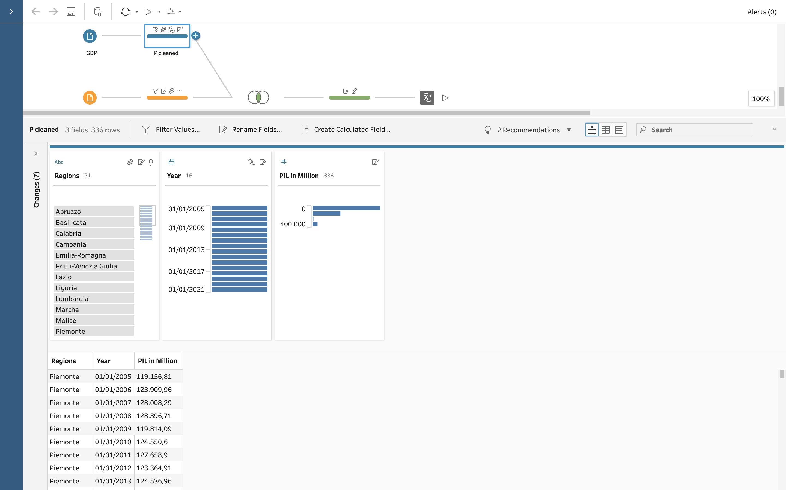
Cleaning and Computing Step
Gross domestic product (GDP) at current market price by NUTS 2 regions table underwent to transformation such as removed the not useful field, Change the type of “TIME_PERIOD” to “Date type”, group value such as geo and renamed some columns.

Slide 12
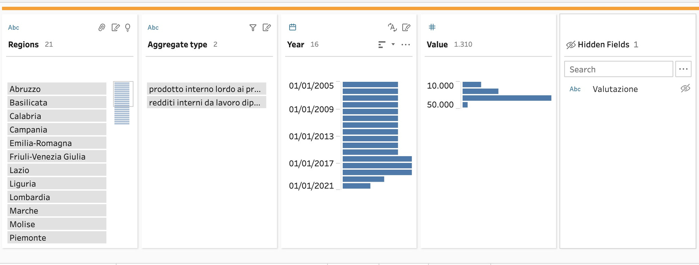
Cleaning and Computing Step
Per capita values table underwent to transformation such as removed the not useful field, change the type of “TIME_PERIOD” to “Date type”, grouping values related to regions, filter some values to exclude them from the analysis and renamed some columns.

Slide 13
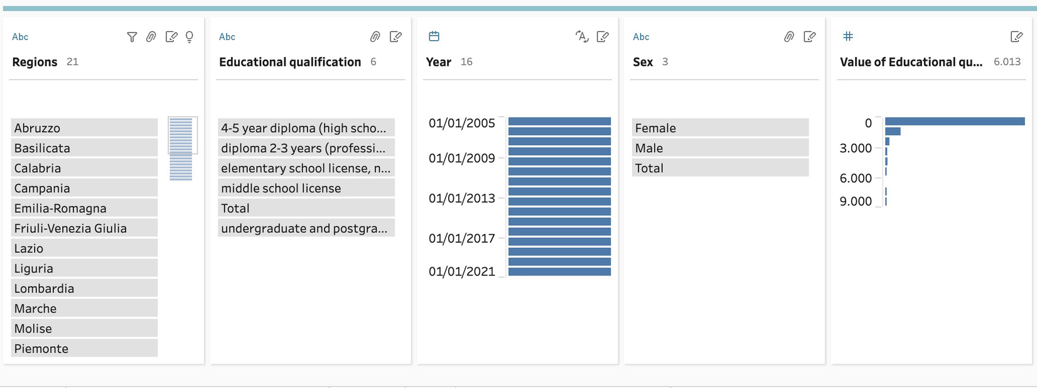
Cleaning and Computing Step
Education table underwent to transformation.
At first, we removed the not useful field, change the type of “TIME_PERIOD” to “Date type”, grouping values related to regions and sex, filter some values to exclude them from the analysis and renamed some columns.
In the second step, we did the pivot from columns to rows of the field Educational qualification and with the cleaning step, we transformed values from millions to percentages through the calculated field.
In the end, we did another pivot from rows to columns to create respectively the fields Education and Education rate.

Slide 14
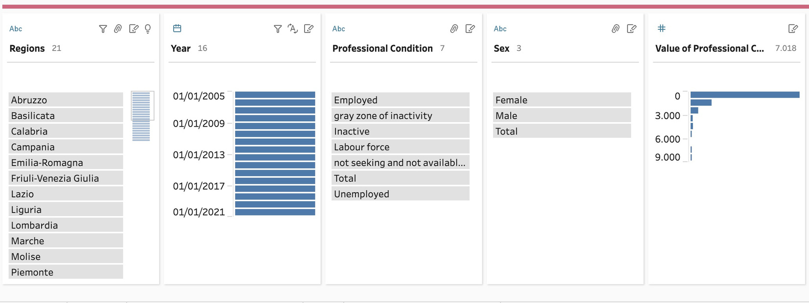
Cleaning and Computing Step
Population table underwent to transformation.
At first, we removed the not useful field, change the type of “TIME_PERIOD” to “Date type”, grouping values related to regions, professional condition and sex, filter some values to exclude them from the analysis and renamed some columns.
In the second step, we did the pivot from columns to rows of the field Professional condition and with the cleaning step, we transformed values from millions to percentages through the calculated field.
Finally, we pivoted from rows to columns to create the professional condition and value of the professional condition fields, respectively.

Slide 15
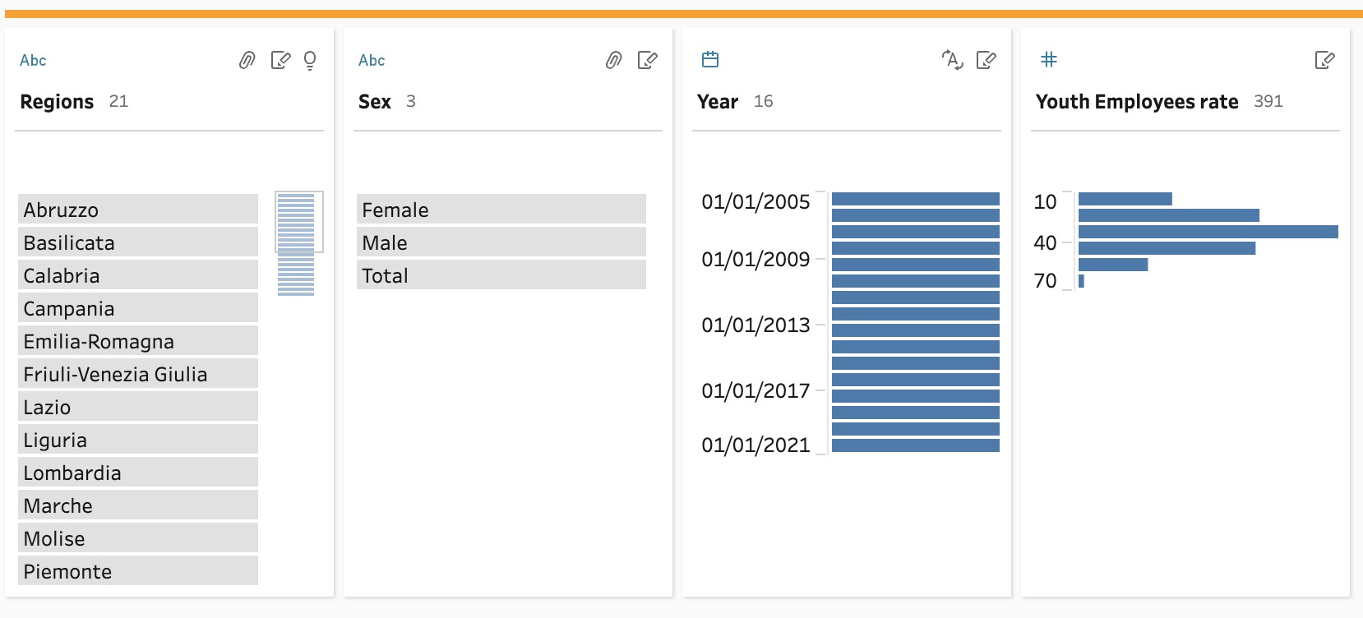
Cleaning and Computing Step
Youth Employees table underwent to transformation.
At first, we removed the not useful field, change the type of “TIME_PERIOD” to “Date type”, group values such as geo and sex.

Slide 16
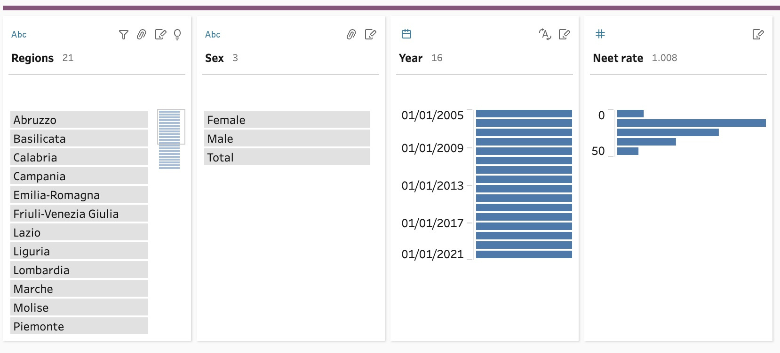
Cleaning and Computing Step
NEETs table underwent to transformation such as removed the not useful field, change the type of “TIME_PERIOD” to “Date type”, grouping values related to regions and sex, filter some values to exclude them from the analysis and renamed some columns.

Slide 17
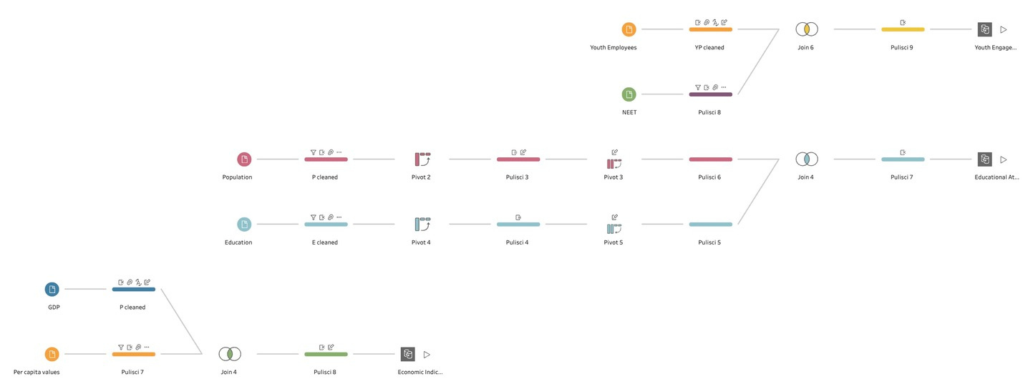
Joining Step
In this step to obtain only three tables, the tables have been joined using inner joins in particular:
In the final table, Economic Indicators have been obtained joining GDP and Per capita values using inner join by year and region.
The final table Educational Attainment and Population Trends has been obtained joining Population and Education using inner join by year, sex, and region.
The final table Youth Engagement and NEET Rates has been obtained joining Youth Employees and NEET using inner join by year, sex, and region.

Slide 18
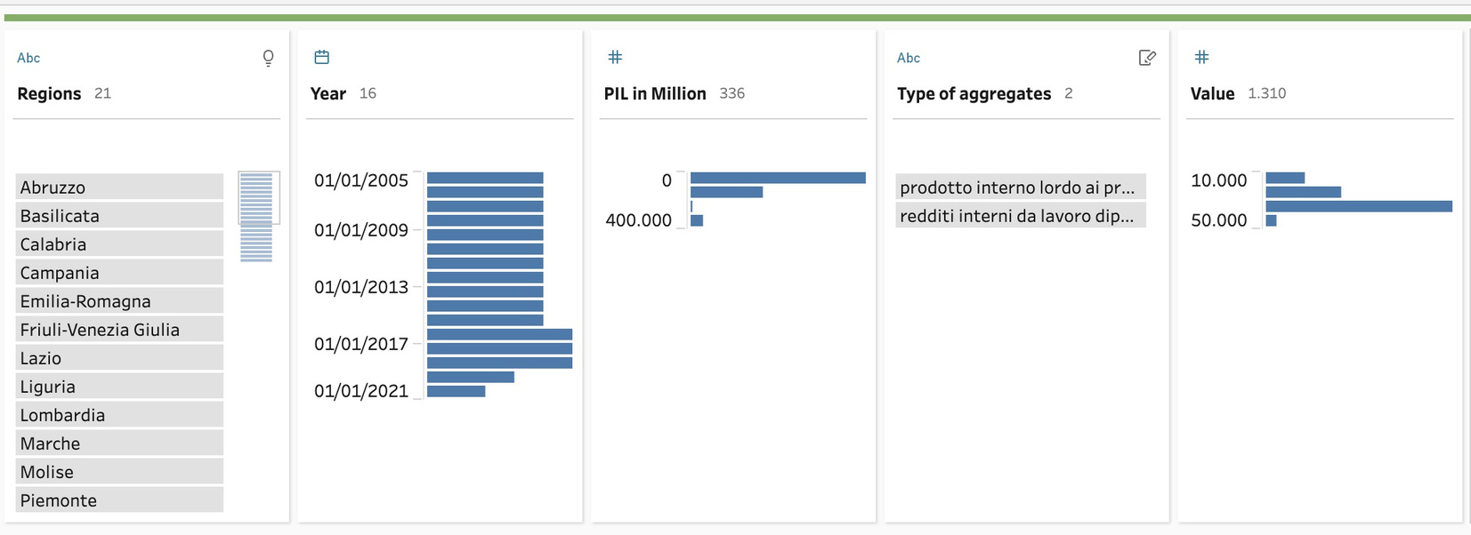
Output Step
Finally, we have obtained three tables:
Economic Indicators table resulted in 2688 rows and only the following 5 columns:

Slide 19
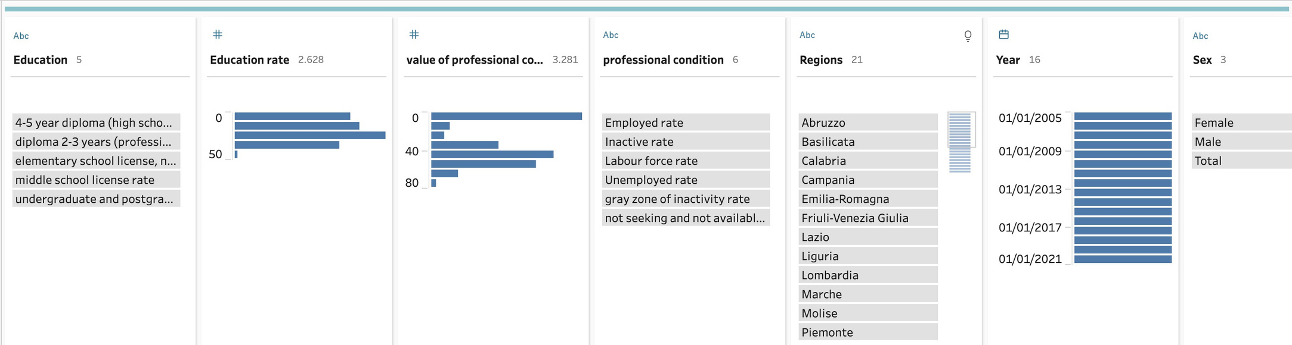
Output Step
Educational Attainment and Population Trends table resulted in 24.192 rows and only the following 7 columns:

Slide 20
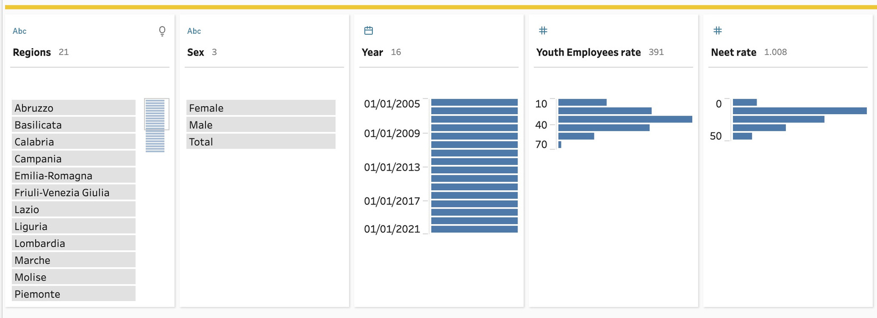
Output Step
Youth Engagement and NEET Rates table resulted in 1008 rows and only the following 5 columns:

Slide 21
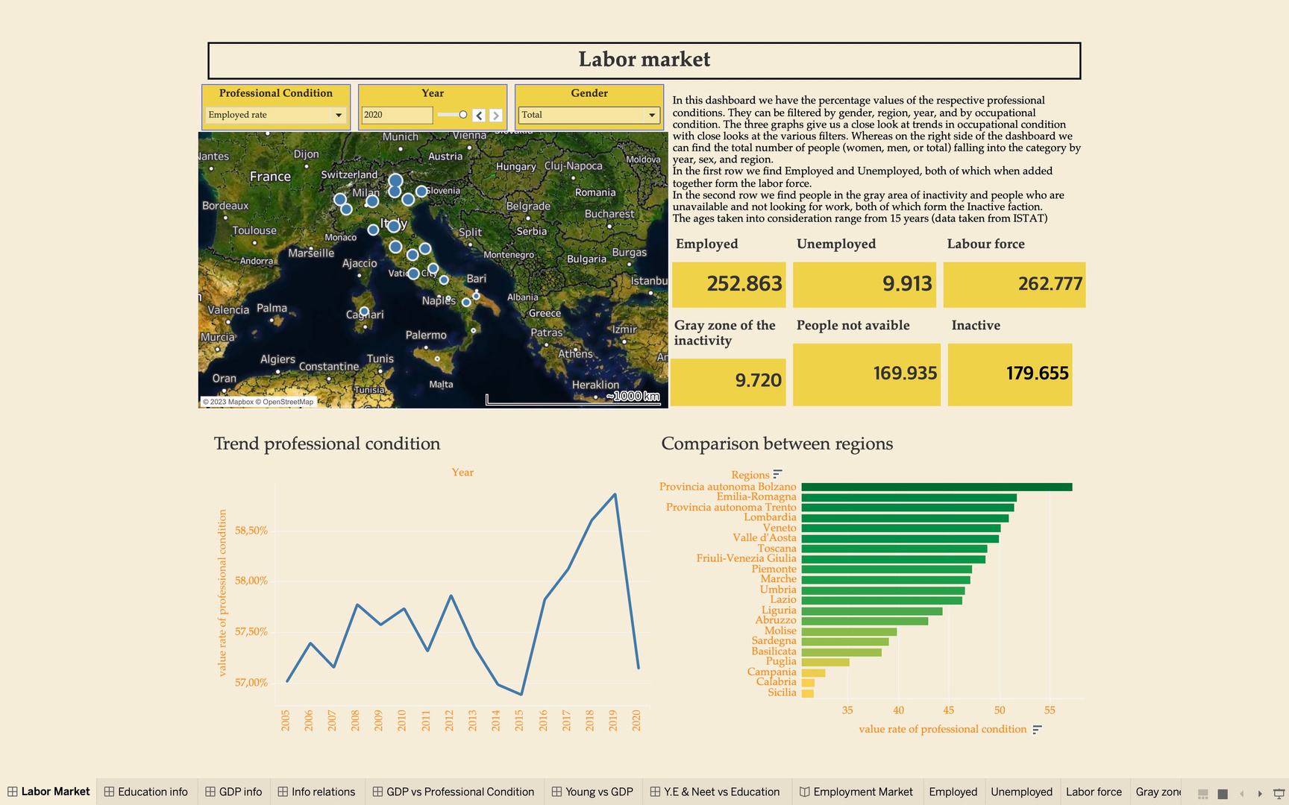
DASHBOARDS 1

Slide 22
DASHBOARDS 1
The first dashboard aims to analyze the labor market in Italy. More specifically, the intention is to best analyze the trends in the various regions and try to understand what does and does not influence market trends. Analyzing Italy can be and certainly is an important yardstick, but from north to south we have significant differences, so the ideal is to analyze the region in more detail, rather the national trend.
As mentioned above, the first dashboard analyzes the labor market by regions and its compositions; it contains the following sheets: professional condition map, professional condition trend, professional condition bar chart, and finally a table where there are the values of employed, unemployed, labor force, gray area of inactivity, not seeking and not available for work, and inactive.
The following filters are available in the dashboard:
The "Year" filter, located in the upper right corner, displays all data for the selected year.
The “professional condition” filter allows the user to view the data collected for each individual type of professional condition.
The sheet ’Professional condition Map’ is also used as filter; through it is indeed possible to view data related to the selected region, or autonomous province.
The “Gender” filter shows data from women, men, or the total. Women's data is calculated on the total of women, same for men, however, for total is calculated on the sum of both gender.

Slide 23
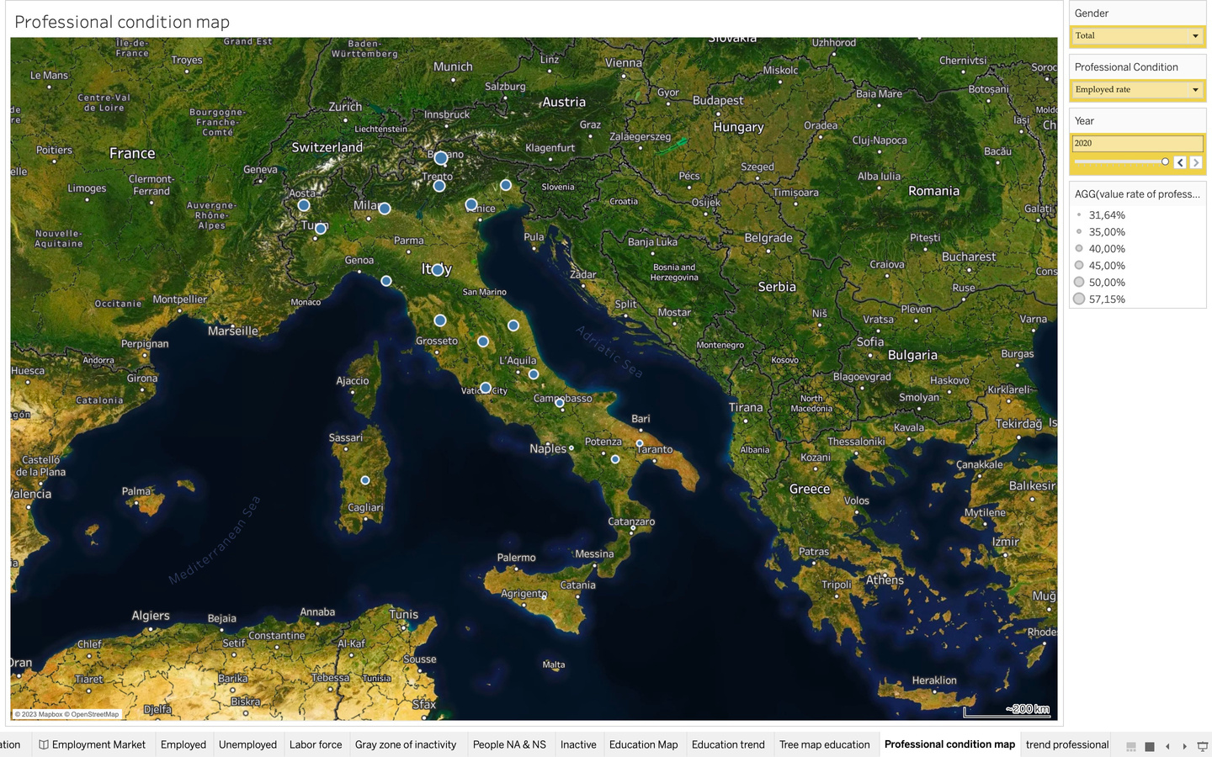
Professional condition map
Map is the best chart when we want to show information using geocoded data for quick visualization and interpretation of data. The professional condition map sheet is a map of Italy divided per regions and autonomous provinces(Trento and Bolzano). This map shows, through the dimension of the circles, the percentage of professional condition per region, year, gender. The map is also used as filter per region for the other sheets. For geocoding I used the NUTS 2 criteria, for the autonomous provinces I manually added the NUTS 2 codes, i.e.,ITH10 and ITH20, in the edit positions.

Slide 24
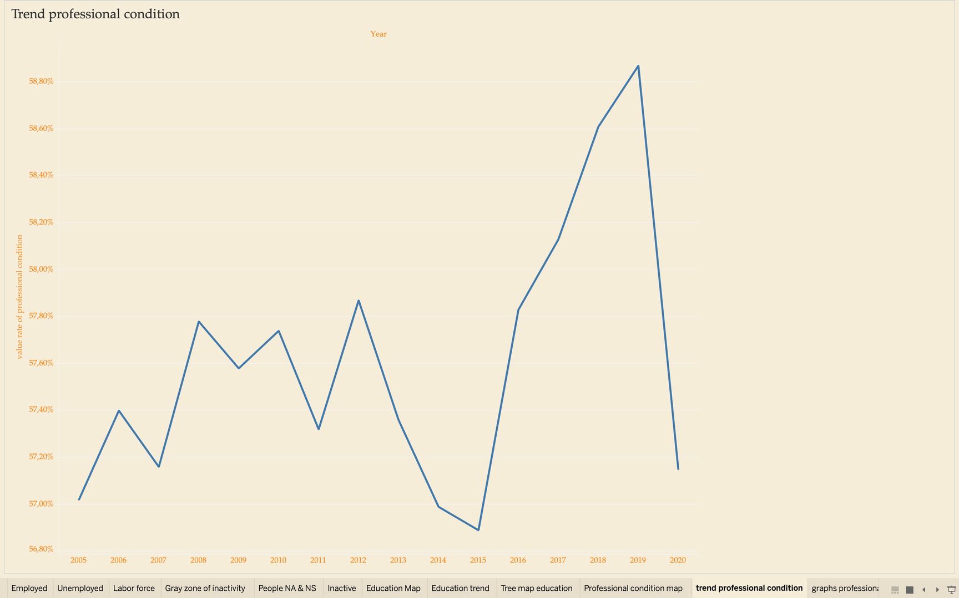
Professional condition trend
Line chart is the most used chart as it is very useful for showing trends over time.
The occupational condition trend shows the trend of various conditions with the ability to filter by gender, region, and professional condition.

Slide 25
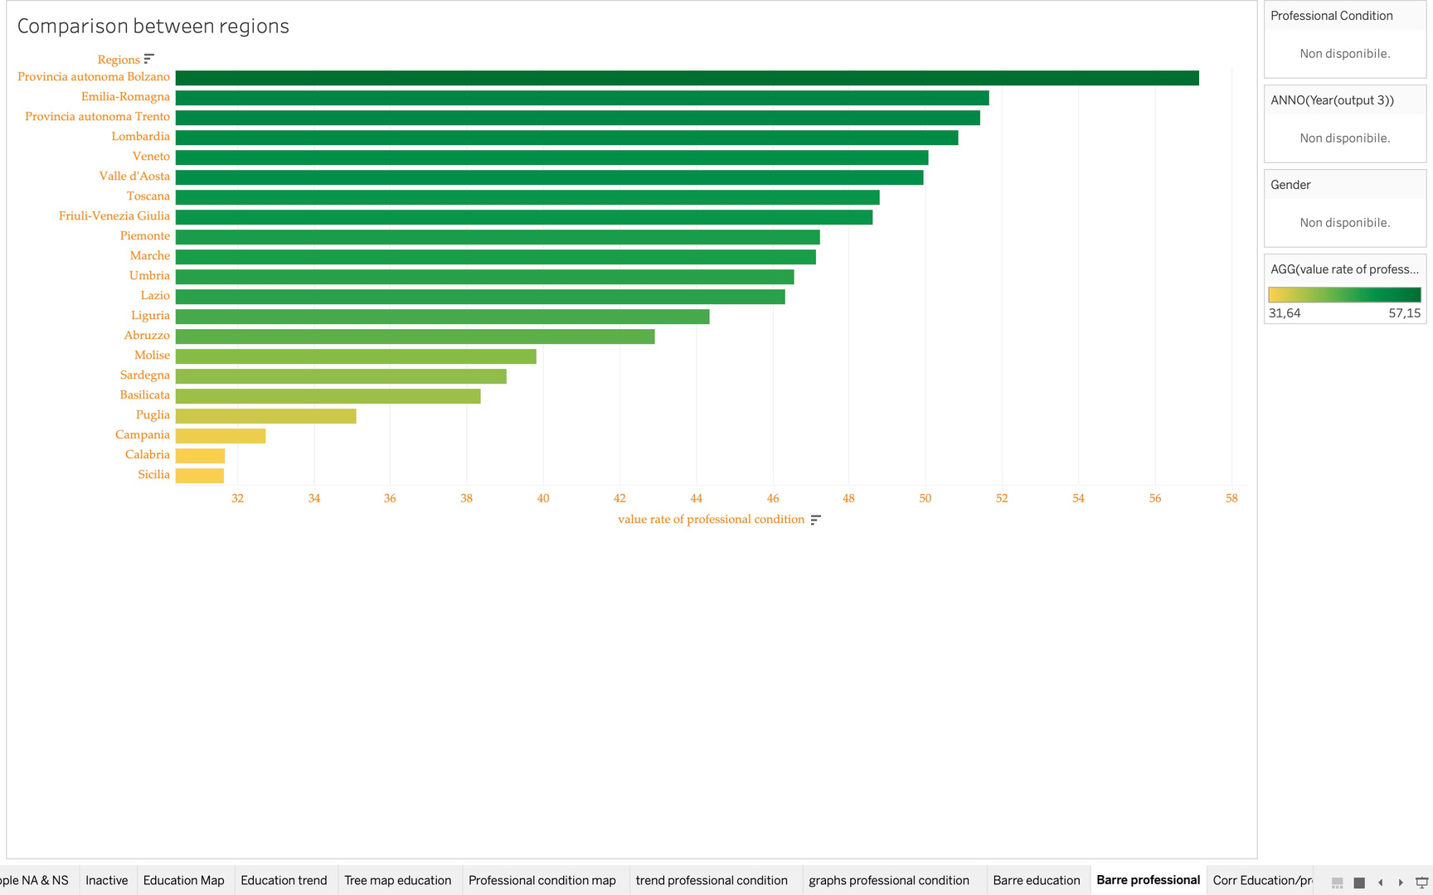
Professional condition bar chart
By using the bar chart, we can compare professional conditions across regions or autonomous provinces. The graph can be filtered by gender, year, and professional condition.
A horizontal bar graph may be preferred over other types of graphs, such as the vertical bar graph, for a few reasons. First, horizontal bars may be easier to read and compare than vertical bars because the length of the bars is horizontally aligned and comparison between bars is easier. Also, a horizontal bar graph can be useful when you have many categories or variables to display, as horizontal bars can be organized over multiple rows without losing their readability.

Slide 26
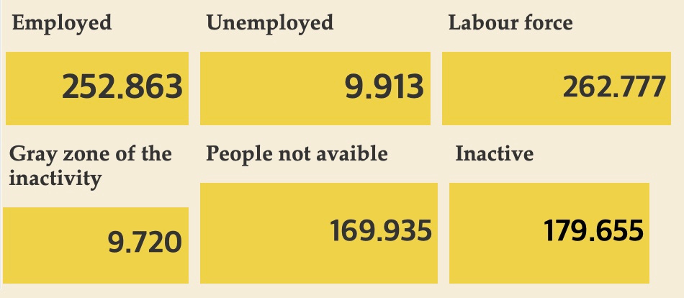
Number of professional conditions
This sheet tells us the data not percentages but numbers of occupational conditions, filtered by year, region, and gender.
Employed +Unemployed = Labor force
Gray zone of the inactivity + people not available = Inactivity

Slide 27
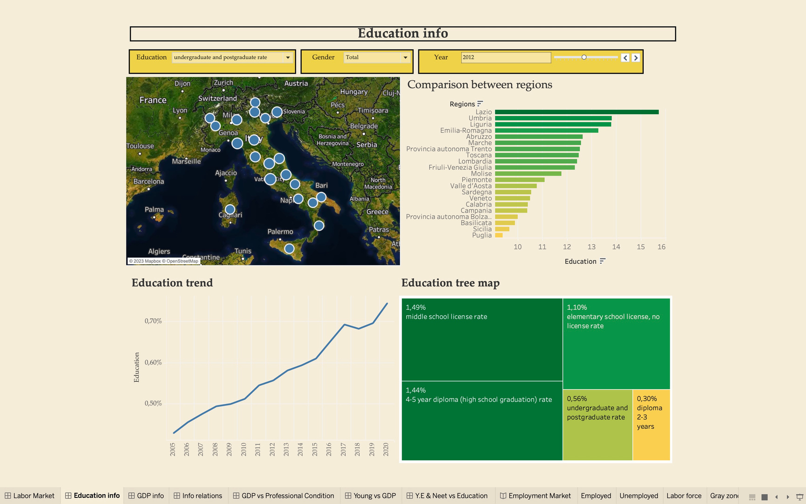
DASHBOARDS 2

Slide 28
DASHBOARDS 2
The second dashboard analyzes the Education by regions and its compositions; it contains the following sheets: education info map, education info trend, education tree map, and finally a comparison between regions.
The following filters are available in the dashboard:
The "Year" filter, located in the upper right corner, displays all data for the selected year.
The “education” filter allows the user to view the data collected for each individual type of education.
The sheet ’Education Map’ is also used as filter; through it is indeed possible to view data related to the selected region, or autonomous province.
The “Gender” filter shows data from women, men, or the total. Women's data is calculated on the total of women, same for men, however, for total is calculated on the sum of both sexes.

Slide 29
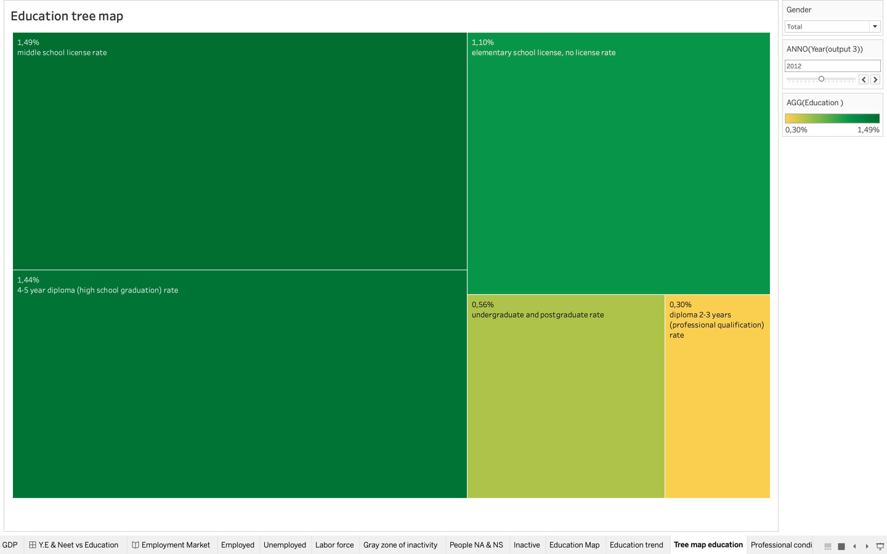
Education tree map
The tree-map functions as a visualization composed of nested rectangles.
These rectangles represent certain categories within a selected dimension and are ordered in a hierarchy, or “tree.” Quantities and patterns can be compared and displayed in a limited chart space. Tree maps represent part to whole relationships.
In this sheet we would represent how the education is divided in one region. The sheet should be filtered by region, gender, and year.

Slide 30
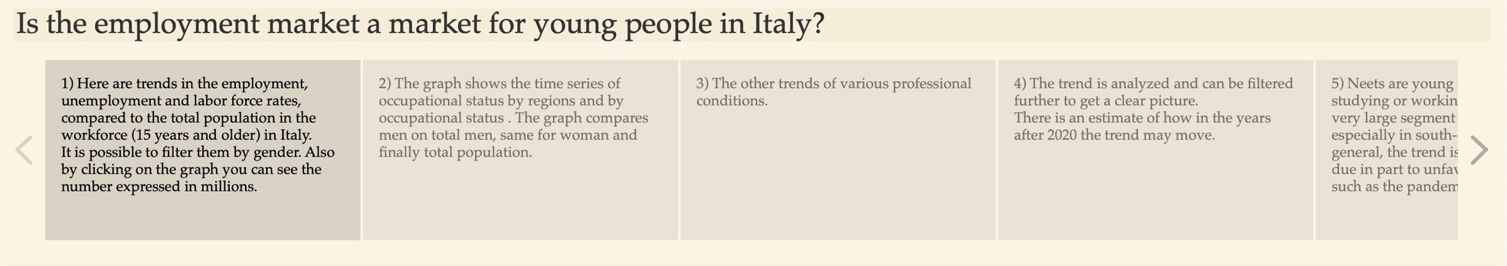
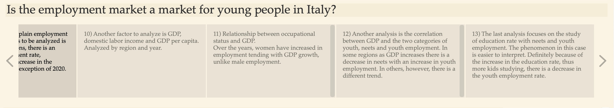
DATA STORY
Using the data story, we want to summarize the milestones of the analysis carried out with the dashboards, step by step. In the first story, you can see trends in employment status by region and by status. The three graphs show the various genders respectively: male, female, and total.

Slide 31
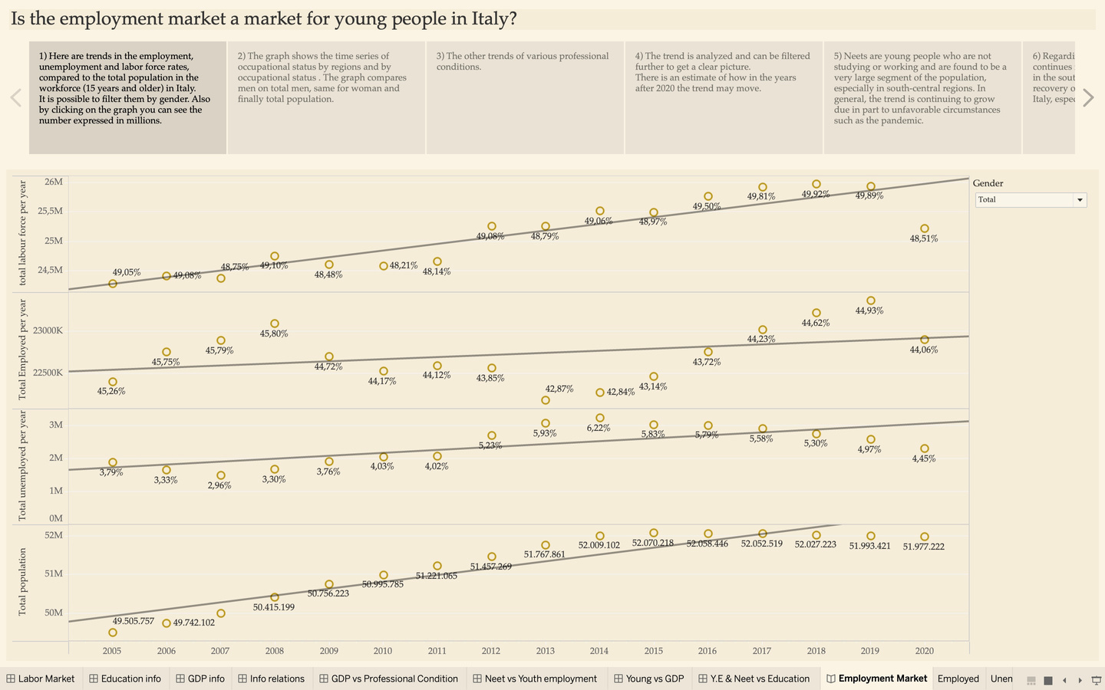
I story
Here are trends in the employment, unemployment and labor force rates, compared to the total population in the workforce (15 years and older) in Italy. It is possible to filter them by gender. Also by clicking on the graph you can see the number expressed in millions.

Slide 32
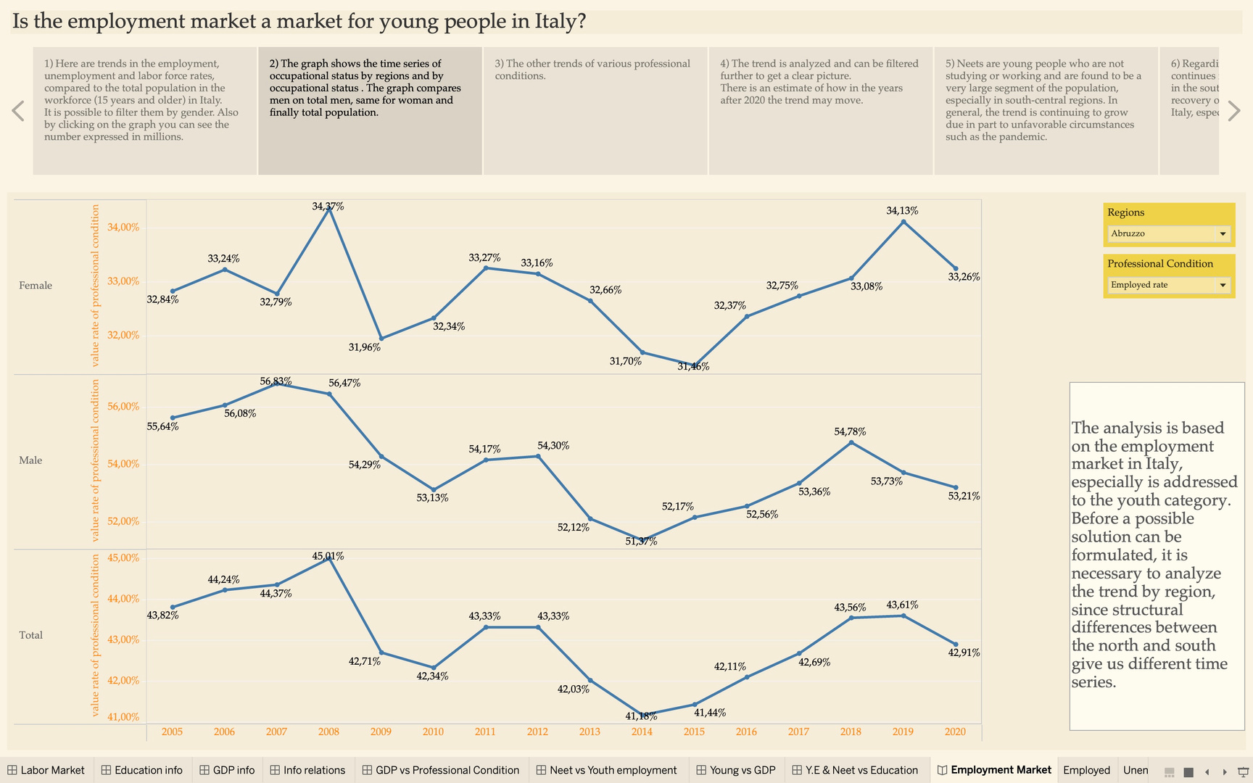
II story
This story answers the first question: what is the trend of various occupational statuses by regions? Having said that, surely you will have a clear idea of how they move over time and the critical issues there are between north vs. south-central.

Slide 33
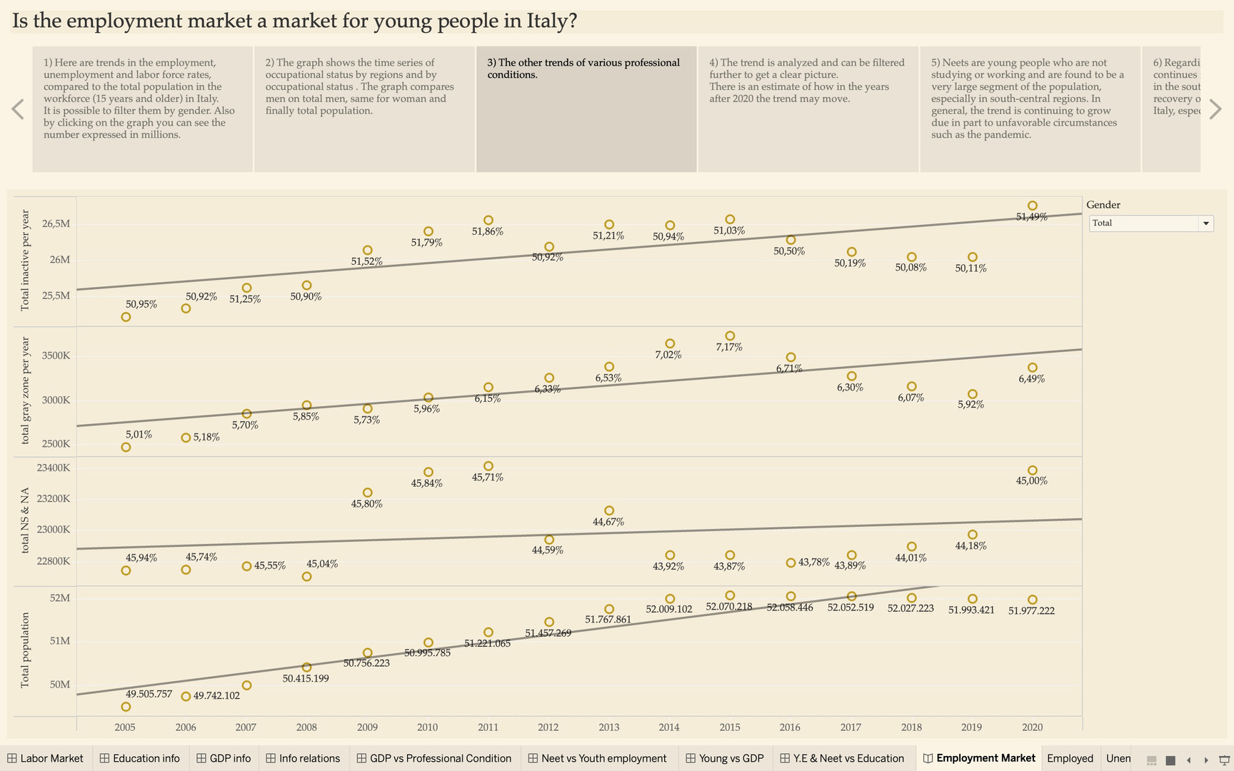
III story
The other trends of various professional conditions such as inactives, gray zone of inactivity, not seeking and unwilling to work.

Slide 34
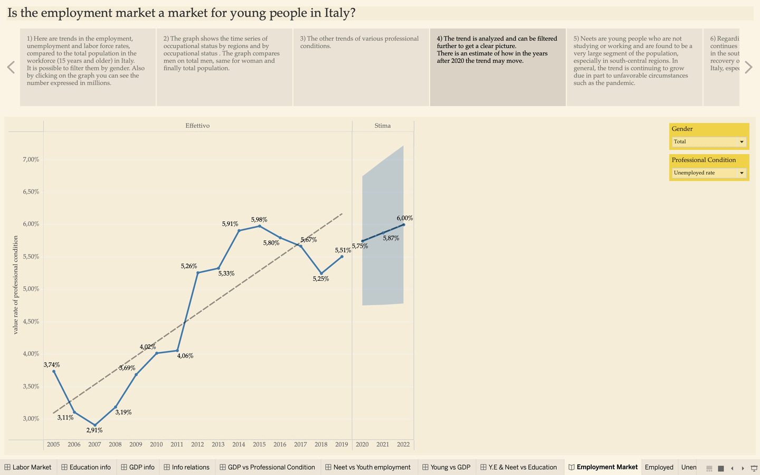
IV story
This story answers the question about the trend. It is true that there have been ups and downs in various professional conditions, but what direction is the trend moving in? Here you can see the trend by region, gender, and occupational condition. The labor force filter along with female is interesting. The trend is almost always increasing for each region. This gives us a sense of the changes taking place within the labor market. This same trend is also reflected in the female employment rate. Opposite trend is for men. Instead, the trend that includes both is often negative. The latter makes us understand how still the employment rate is mostly influenced by men than by women.

Slide 35
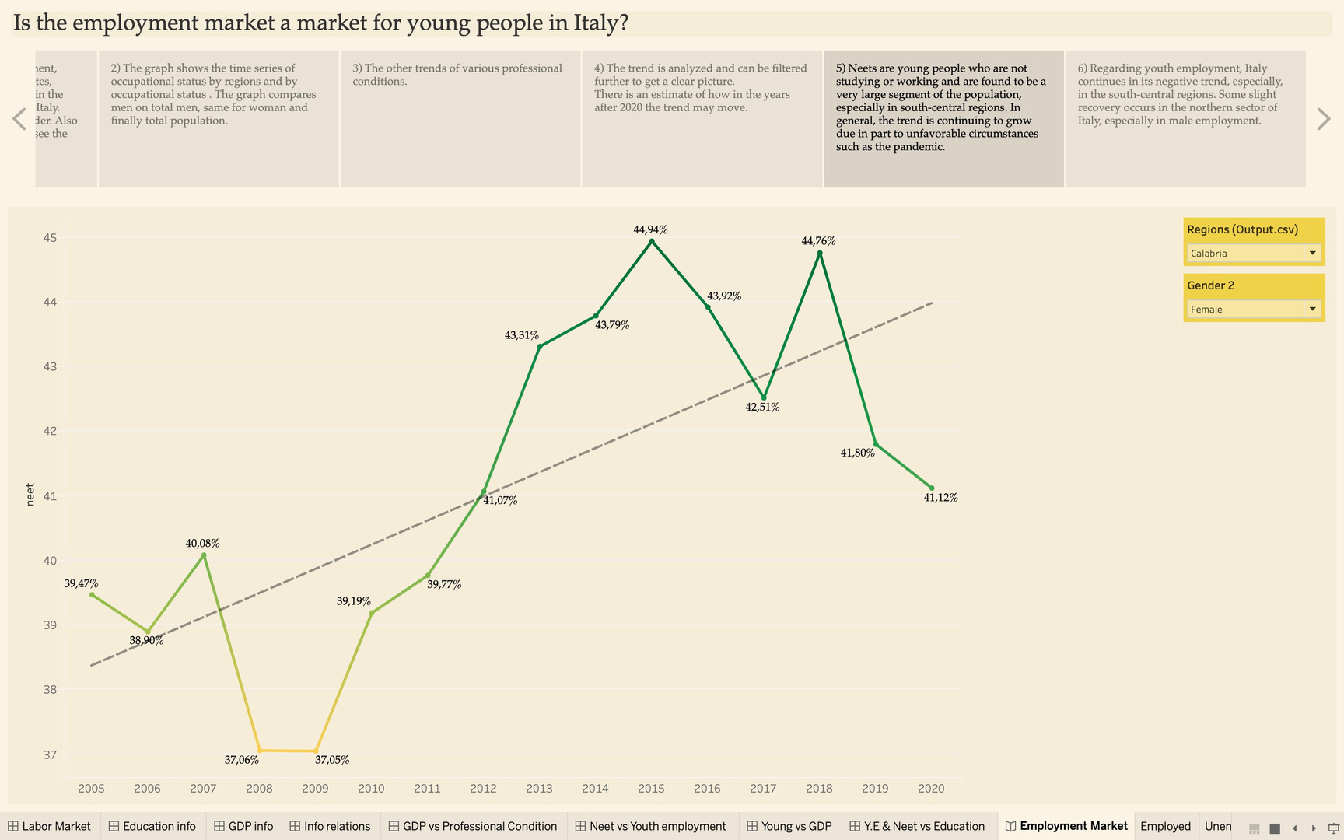
V story
This story shows the graph of Neets by gender and region. From here, you can see the trend for each individual region. Unanimously, it can be said that they are increasing in each region for both women and men. They are certainly increasing at different rates. Very negative result for southern Italy, more contained the phenomenon in the north.

Slide 36
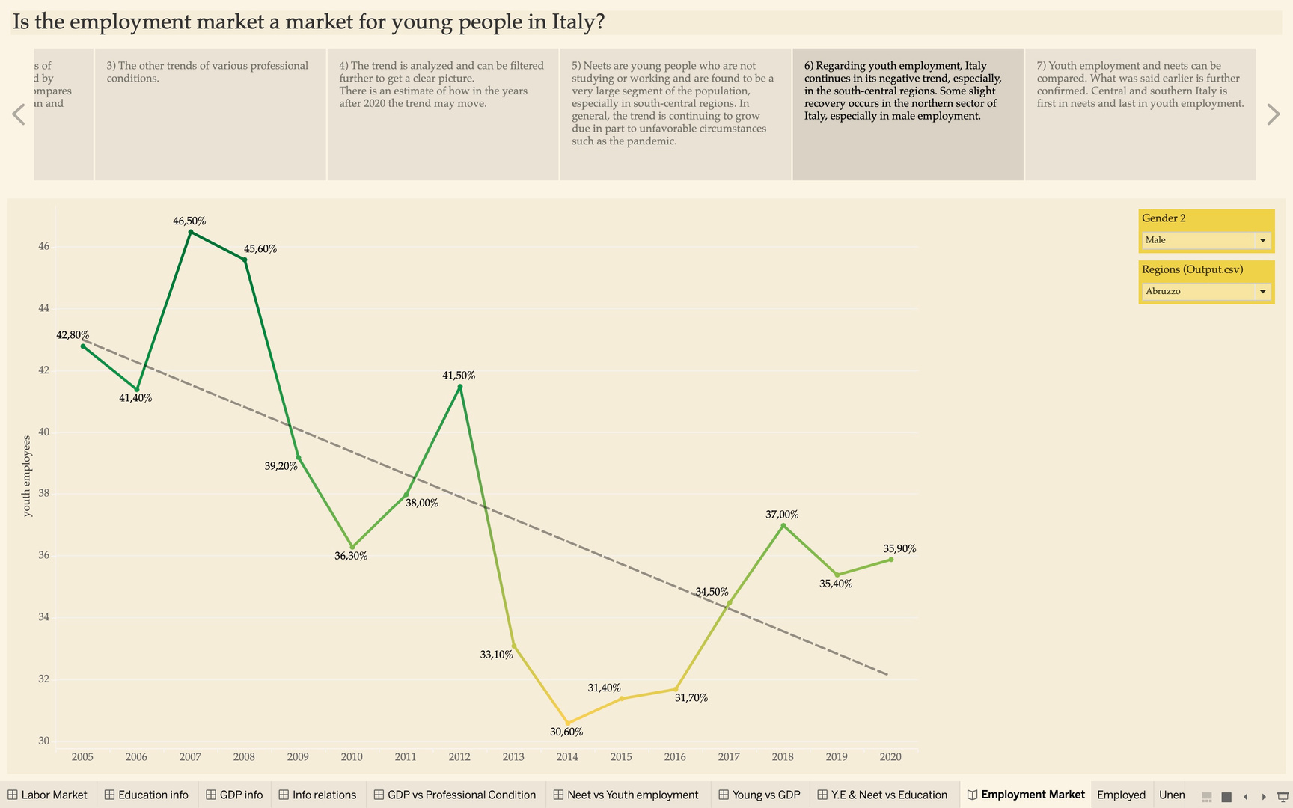
VI story
Instead, in this story we have the graph showing us the trend of youth employment (18-29 years old) by gender and region. If Neets increase as a result youth employment will drop. But what are the causes? From the worksheet you can change regions and gender, but unanimously there is a downward trend, everywhere.

Slide 37
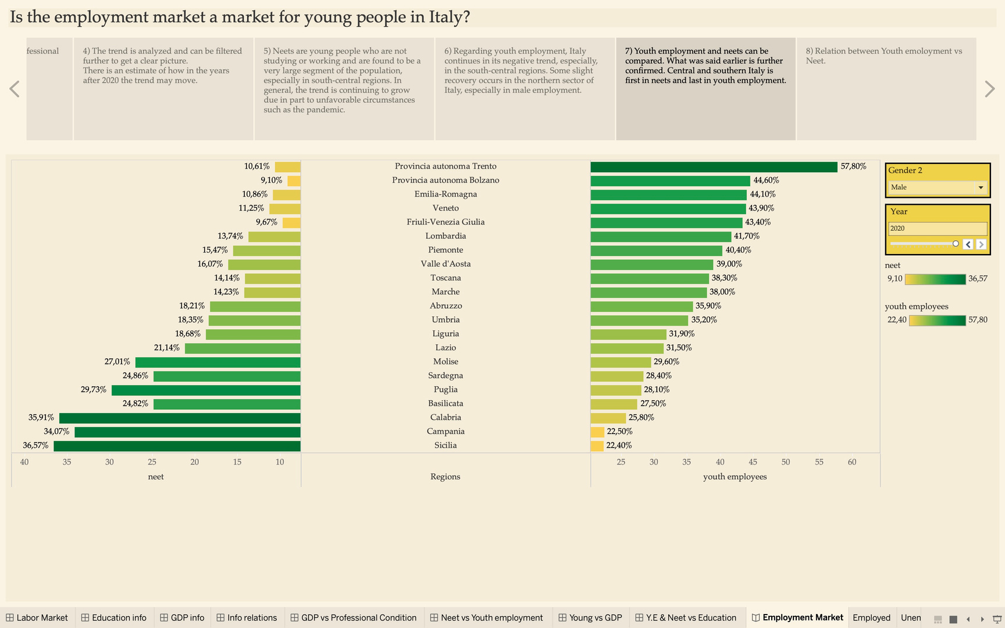
VII story
In this story we find the cross-regional comparison of Neets and youth employment in a single graph. They can be filtered by year and gender. This graph allows considerations to be made about the various regions of Italy. As mentioned earlier, the south confirms its negative trend.

Slide 38
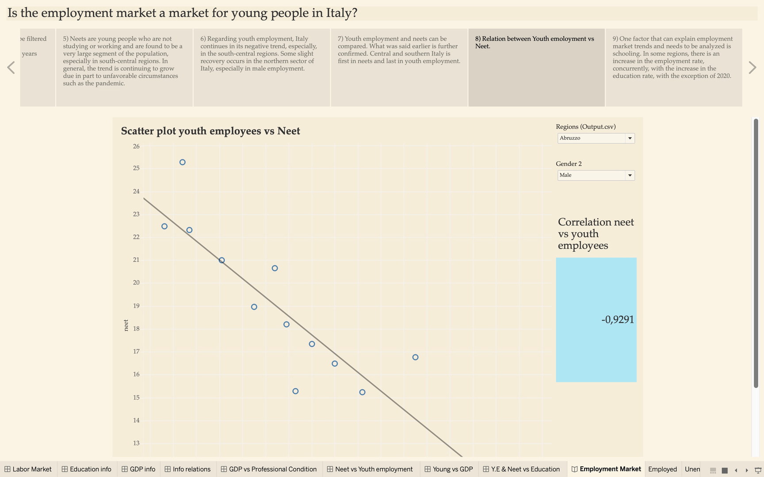
VIII story
We want to show the relationship between Youth emoloyment and Neet through a scatter plot, filtering by regions and gender. The story also shows the correlation between YE and Neet which is negative, so it means that if YE rate increases, Neet rate decreases and vice versa.

Slide 39
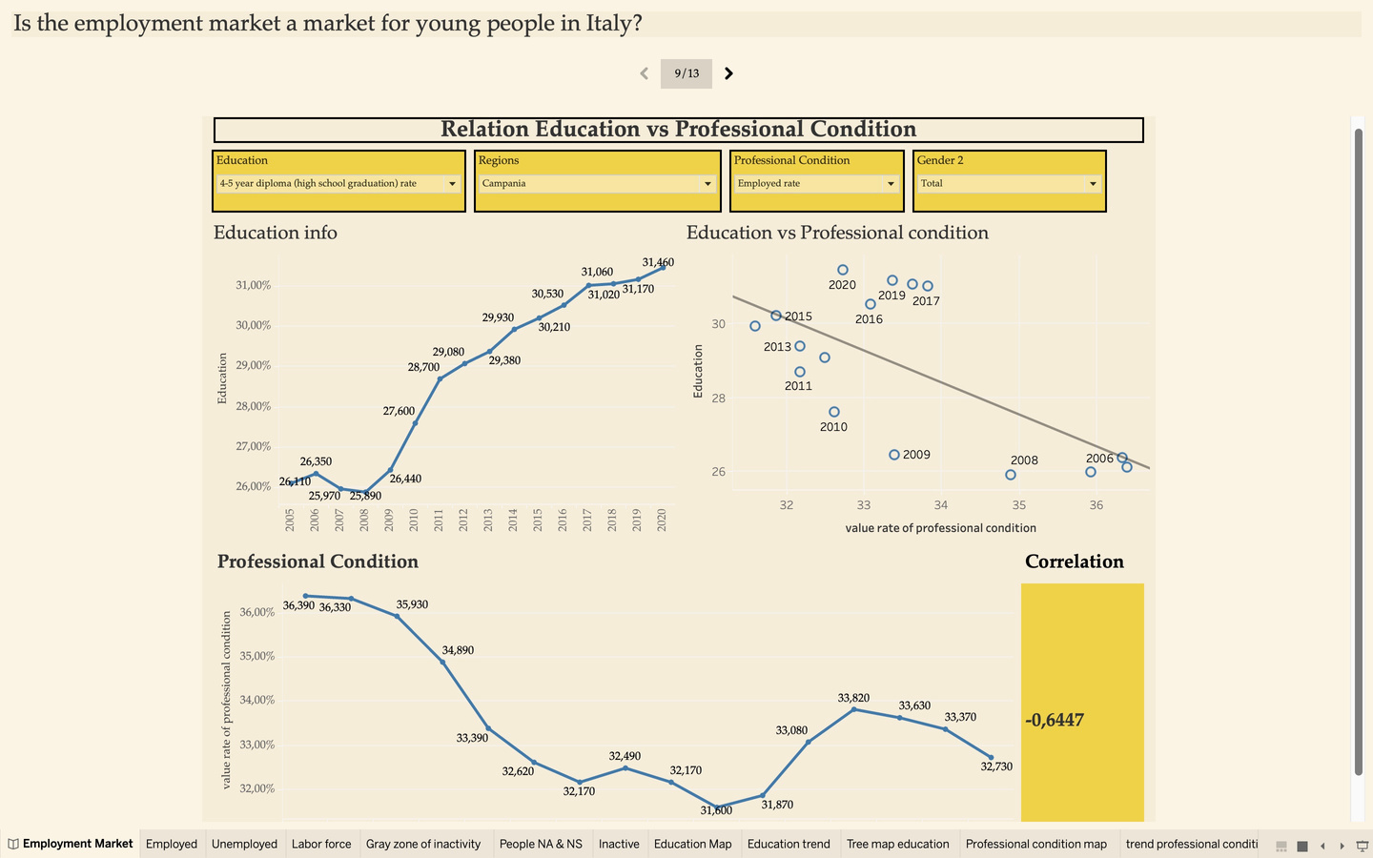
IX story
In this story, dashboard 4 is taken up. This dashboard depicts the relationship between occupational status and education level. We want to understand whether there is a positive relationship between the two variables. If we look at the male employment rate, we see that there isa negative relationship between those with a bachelor's degree or more and the employment rate. Of a different trend is the female trend, which on the contrary increases along with the level of education.

Slide 40
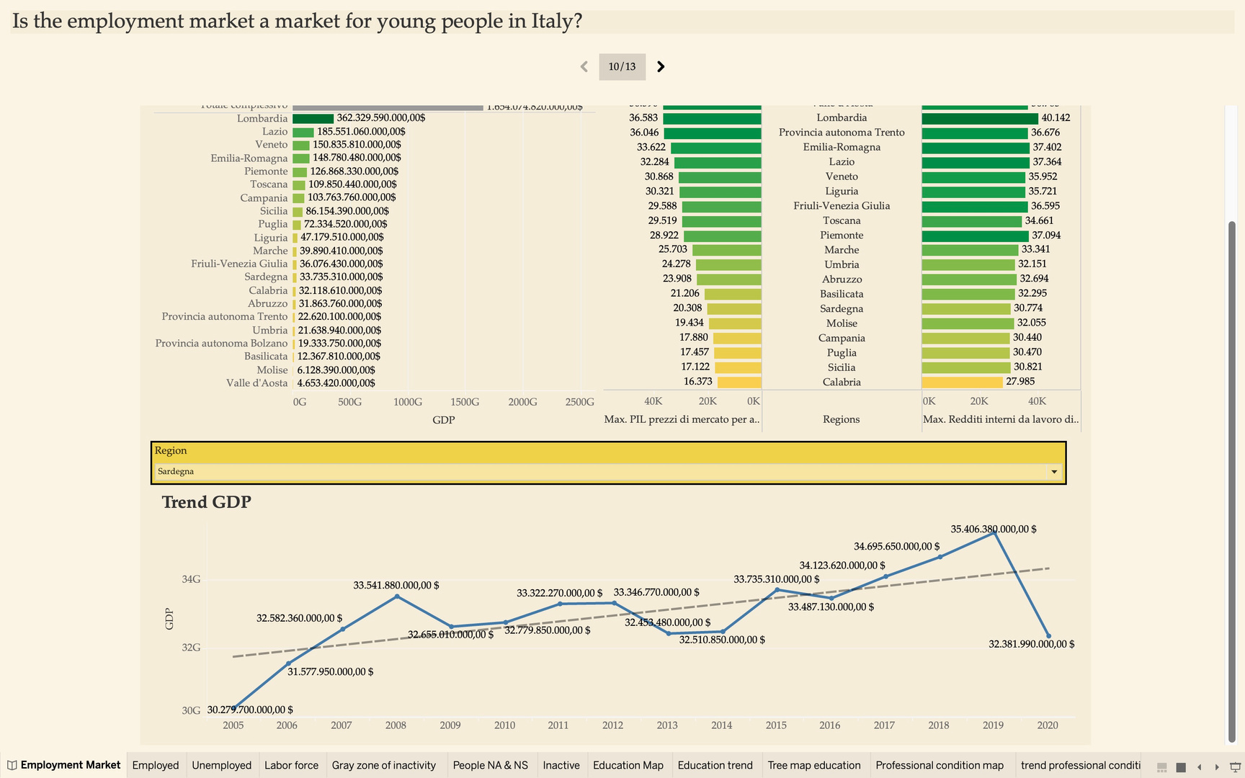
X story
In this story, GDP is analyzed using dashboard 3. Here we want to analyze GDP and other economic factors by region and year.So, you can get a clear picture of the economic situation, broadly speaking of course.

Slide 41
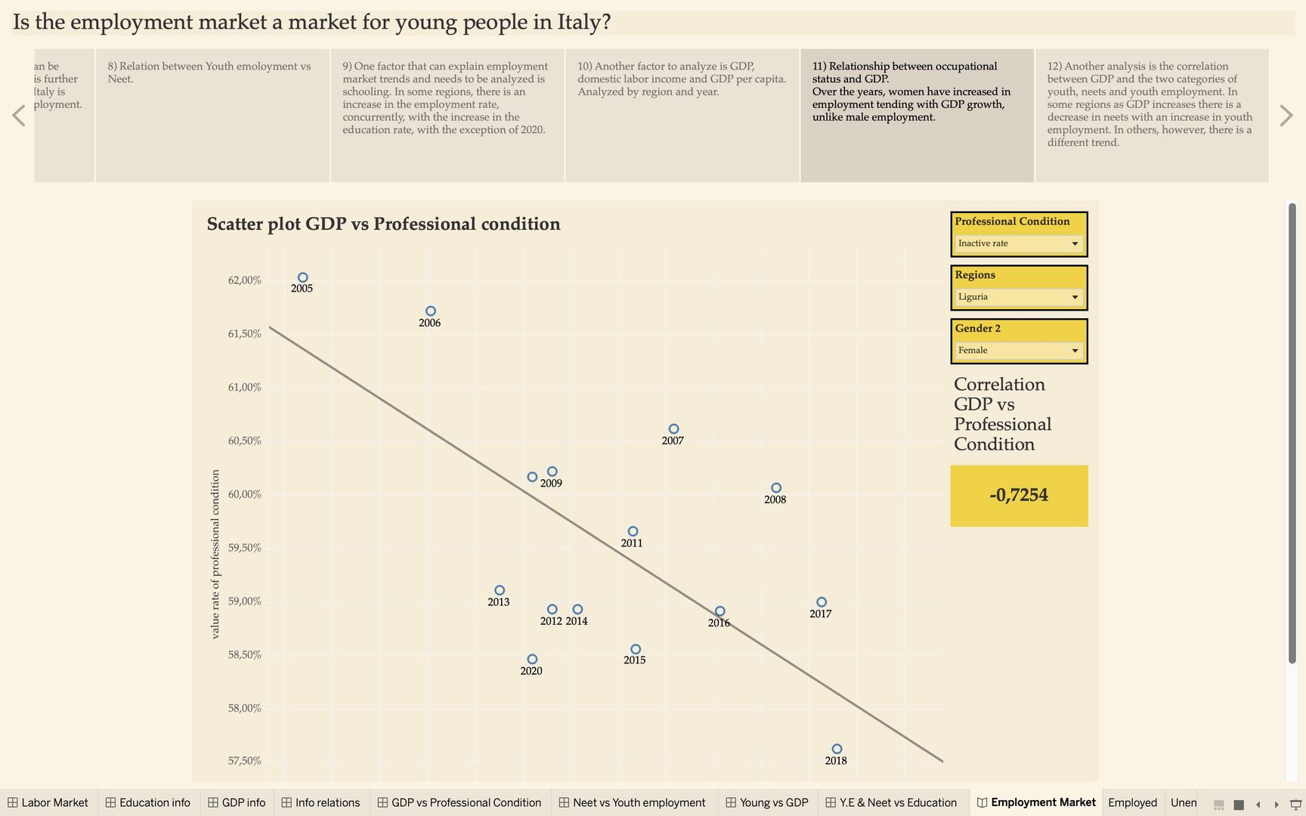
XI story
In this story, dashboard 5 is taken up, where there is the relationship between two variables such as GDP and occupational status. In this dashboard it is possible, through filters, to relate occupational status to GDP. It is possible to see how as GDP increases the female employment rate increases, for the male employment rate there is the opposite trend.

Slide 42
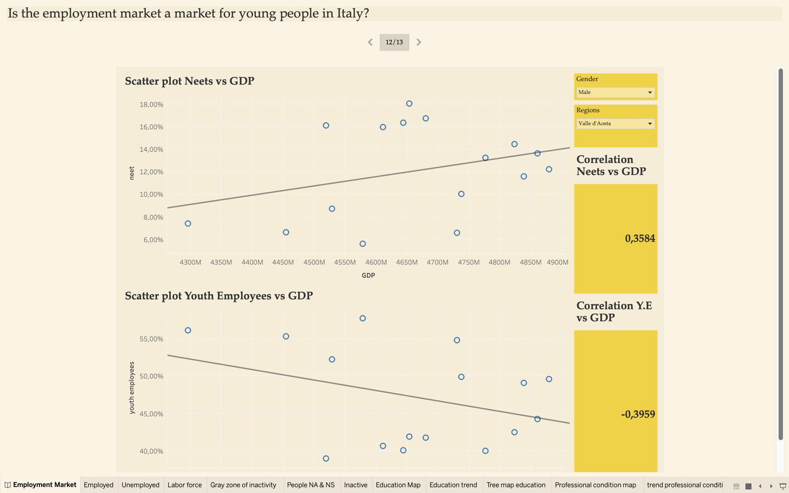
XII story
In this story we find the relationship between the two categories of youth examined and GDP. It is possible to filter by gender and by region. The relationships are quite different from gender to gender and by region. For example, in the central, southern and island regions there is an increase in youth employment and a decrease in Neets in corresponding to increase in GDP. Different story for northern regions. So, this can certainly be a growth factor for the central, southern and island regions but up to a certain point.

Slide 43
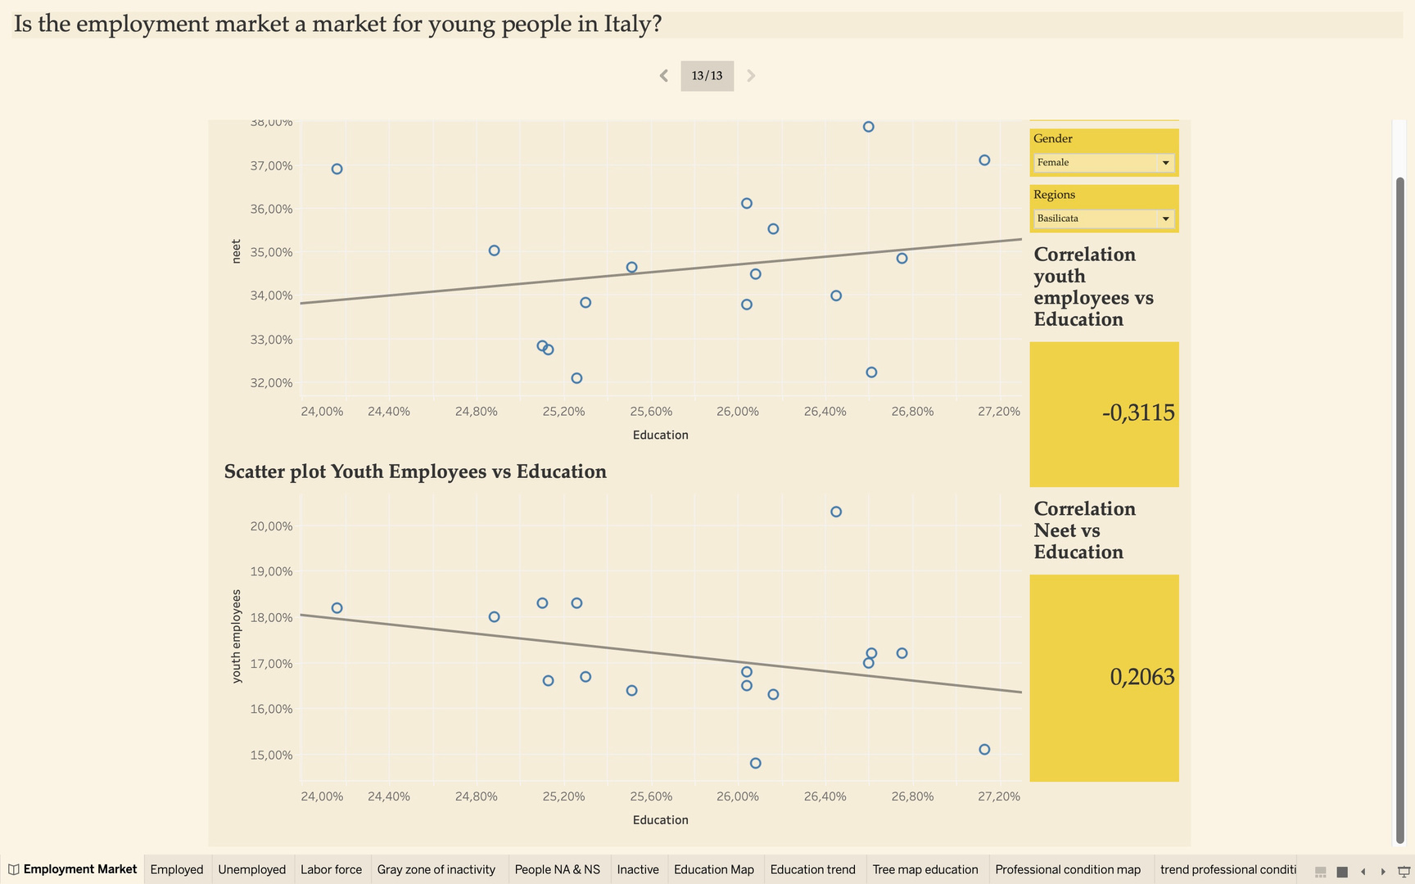
XIII story
The last analysis focuses on the study of education rate with neets and youth employment. The phenomenon in this case is easier to interpret. Definitely because of the increase in the education rate, thus more kids studying, there is a decrease in the youth employment rate.

Slide 44

ANALYSIS REPORT
Using dashboards and with the help of data story, it is possible to describe a complex phenomenon such as Neets and youth employment, starting with an analysis of more general occupational status.
In the first dashboard, it is possible to have a comprehensive analysis by region, by gender on occupational status.
The aim of the report is to study and analyze these phenomena, taking advantage of data collected by ISTAT and EUROSTAT over time.
The "rationale" is to understand why there is an increase in neets and a decrease in youth employment.
Over the years the trend of neets has increased and vice versa youth employment has remained very low, mainly in the central, southern and island regions.

Slide 45


First Question
How has the trend of total employment and unemployment rate varied over the years in Italy?
National Employment Rate:
The highest employment rate was in 2008 at 45.8%.
Subsequently, there was a decline, reaching a low of 42.84% in 2014.
There was a slight recovery to 44.93% in 2019, followed by a decrease to 44.06% in 2020.
National Unemployment Rate:
Italy experienced a decrease in the unemployment rate from 2007 to 2008, hitting its lowest point at 2.96% just before the 2008 financial crisis.
After 2008, there was a steady increase in unemployment until 2014 when it peaked at 6.22%.
From 2014 onwards, there was a gradual decrease, reaching 4.45% in 2020. However, there's an expected increase in the following years due to the pandemic.

Slide 46


First Question
a) How has the trend of female employment and unemployment rate varied over the years in Italy?
Female Employment:
The female employment rate showed an upward trend, peaking at 36.68% in 2019 and decreasing to 35.78% in 2020.
Female Unemployment:
The lowest female unemployment rate was 2.97% in 2007.
The highest rate occurred in 2014 at 5.54% and then gradually decreased to 4.06% in 2020.
b) How has the trend of male employment and unemployment rate varied across over the years in Italy?
Male Employment:
The male employment rate peaked in 2006 at 57.54%.
It experienced a decline until 2014 when it was 51.74% and then showed a gradual recovery to 52.95% in 2020.
Male Unemployment:
The lowest male unemployment rate was 2.95% in 2007.
The highest rate occurred in 2014 at 6.96% and then gradually decreased to 4.86% in 2020.

Slide 47


First Question
c) And what about Sicily?
Regional Variation:
Sicily had a consistently lower employment rate, around 30%, compared to regions like Bolzano and Lombardy, where rates hovered around 50-60%.
Sicily's employment rate peaked in 2006 at 35.84% and declined to 30.51% in 2014, with a slight increase to 31.64% by 2020.
The unemployment rate in Sicily was among the highest in Italy, reaching 8.86% in 2016 but decreasing to 6.89% in 2020, before the pandemic.
Data Analysis
The data reveals a fluctuating pattern of employment and unemployment rates in Italy, with significant regional variations. The global financial crisis of 2008 had a notable impact on these trends, and the subsequent recovery was interrupted by the COVID-19 pandemic. Sicily consistently lags behind other regions in terms of employment rates and faces a persistent challenge with higher unemployment rates.

Slide 48


Second Question
What is the trend of other occupational conditions such as inactive, not seeking and unwilling to work and gray area of inactivity?
Inactives:
Inactives represent individuals who have not actively sought work in the four weeks preceding the reference week or are unwilling to work within the next two weeks, or both.
The trend for inactives remained consistently around 50% during this period.
Peaks were observed in 2011 at 51.86% and in 2020 at 51.49%, while the lowest value in this timeframe was in 2018 at 50.08%.
Gray Area of Inactivity:
The "gray zone of inactivity" includes individuals who, although not officially considered unemployed by statistical definitions, would be available for work if given the opportunity.
This trend increased until 2015, reaching 7.17%, and then fluctuated in subsequent years, stabilizing at 6.49% by 2020.
Not Seeking and Unwilling to Work:
This category includes individuals who are not employed and are not actively seeking employment.
The trend for not seeking and unwilling to work remained around 40%.
Peak values were observed in both 2011 and 2020, with rates of 45.71% and 45%, respectively, while the lowest peak occurred in 2015 at 43.87%.

Slide 49
Third Question
What is the best region in terms of youth employment and with a lower rate of Neets?
To answer the thrid question, we use the seventh data story, where there are the two categories of youth, Neets and youth employment rate by region, gender, and year.
Regional Disparities:
Northern regions, particularly the Autonomous Province of Trento, outperform others in terms of youth employment rates. In 2019, Trento had a youth employment rate of 52% and a NEET rate of approximately 13.15% for the entire youth population.
When considering gender, there is a notable difference. The male youth population in Trento had a youth employment rate of 57% and a NEET rate of 8.7%, while the female youth population had an employment rate of around 47% and a NEET rate of 17.77%.
In contrast, the South-Southern Island regions exhibit lower youth employment rates and higher NEET rates.

Slide 50
Third Question
a) What is the correlation between youth employment rate and Neets rate?
To answer the first sub-question, we can look at the eighth story, where there is the scatterplot between Neets and youth employment and the correlation index between the two variables.
Correlation Between NEETs and Youth Employment:
The analysis shows a consistently negative and very high correlation between NEETs and youth employment rates. This implies that as NEET rates increase, youth employment rates decrease, and vice versa.
b) And what about Sicily?
To answer the second sub-question, we can use the fifth and sixth data stories.
Sicily's Situation:
Sicily presents a different scenario compared to the northern regions. The trend in the number of NEETs in Sicily has been increasing, with occasional decreases after 2014. NEET rates are around 41% for the total youth population, 36.57% for males, and 45.69% for females.
Youth employment rates in Sicily have significantly declined over the years, especially after the 2008 financial crisis, to less than 18%, with 12.5% for females and 22.4% for males.

Slide 51


Third Question
c) What is the picture of the Italian regions, in terms of Neets and youth employment, in 2019, 2020 and before the 2008 crisis?
To answer the third sub-question, we can use the seventh data story.
Historical Perspective:
A historical analysis reveals that the situation in Italy before the 2008 financial crisis was similar to more recent years, with lower NEET rates and higher youth employment rates.
In 2019, the regional disparities persisted, with the North outperforming the South.
It's worth noting that even 11 years after the crisis, the percentages had not returned to pre-crisis levels. The COVID-19 pandemic in 2020 further impacted the situation, causing decreases in youth employment rates and increases in NEET rates.
Data Analysis
The analysis underscores the substantial regional disparities in youth employment and NEET rates within Italy, with the North generally performing better than the South. The strong negative correlation between NEETs and youth employment rates highlights the inverse relationship between these two variables. Sicily, in particular, faces challenges with increasing NEET rates and declining youth employment rates over the years.

Slide 52
Fourth Question
What is the relationship between GDP and employment and unemployment rates in different regions?
To answer the fourth question, we focus on the eleventh data story, which is the relationship between GDP and working conditions.
GDP as a Health Indicator:
GDP declined sharply after the 2008 financial crisis, leading to increased unemployment and job insecurity.
GDP Recovery:
After the 2008 crisis, GDP exceeded pre-crisis levels around 2015 and continued to grow until a setback in 2020.
Correlation between GDP and Employment:
Positive correlation observed between GDP and employment rates in some South-Central and Northern regions.
Correlation index varies, generally not falling below -0.3.
Female employment rates show higher correlations with GDP than male rates in most regions.
Examples from Sicily and Puglia illustrate varying correlations.
Contradictory Unemployment Trends:
In some regions with rising employment rates, unemployment rates also increased due to more people entering the labor force.

Slide 53

Fourth Question
a) And what about Neets?
To answer the second and third sub-question, we can use the twelfth data story.
Correlation with NEETs:
Low negative correlation between NEETs and GDP in the South.
In the North and Central regions, negative correlation between youth employment and GDP, and positive correlation with NEETs.
Suggests that GDP growth has a slight positive impact on youth employment in low GDP regions.
b) And what about youth employment?
Youth Employment Trends:
Youth employment rates reversed their trend around 2015, generally increasing, albeit slowly.
Low positive correlation between youth employment and GDP in some Southern regions.
Suggests that GDP growth has a slight positive impact on youth employment in low GDP regions.
Data Analysis
The analysis highlights the complex and region-specific nature of the relationship between GDP, employment, unemployment, and NEETs. The impact of GDP growth varies across regions and genders, and there are instances where increasing employment coexists with rising unemployment due to changes in the labor force composition.

Slide 54
Fifth Question
What is the relationship between education rate and employment and unemployment rate?
To answer the fifth question, we use the ninth story, where there is a relationship between occupational status, in particular unemployment and employment rates, and educational attainment.
Regional Variations: Italy's regional structures vary significantly, impacting the types of workers they accommodate. For example, Sicily, primarily an agricultural-tourist region, may struggle to retain graduates outside specific sectors.
Brain Drain Phenomenon: Contrary to the notion of a purely southern brain drain, the phenomenon affects almost the entire country, except for some exceptions like the autonomous province of Bolzano. This is supported by various correlation indices.
Unemployment and Graduates: There is a positive correlation between the unemployment rate and the number of graduates in all regions, suggesting that more graduates do not necessarily lead to lower unemployment.
Gender Disparities: When considering women, a positive correlation between graduation and employment rate is observed in much of Italy. However, when considering both men and women together, the correlation between employment rate and the number of graduates is negative, primarily due to men's greater presence in the labor market despite having fewer graduates.

Slide 55

Fifth Question
a-b) And what about Neets and Youth employment??
To answer the second and third sub-question, we can use the thirteenth data story.
NEETs and Education: There is a negative correlation between the number of graduates and youth employment, as students rarely work while studying. Conversely, the NEETs rate tends to increase as the level of education rises in various regions.
Low Education Levels: At lower education levels, such as primary, a positive correlation with employment is observed.
Data Analysis
The analysis illustrates the intricate relationship between educational attainment, employment, and NEETs rates across different regions of Italy. It dispels the notion that the brain drain is solely a southern phenomenon and highlights how gender disparities and regional economic structures contribute to these dynamics.

Slide 56


Sixth Question
How can the situation of Neets and youth employment in Italy be improved?
Long-Term Challenge: The analysis acknowledges that solving youth unemployment and NEETs is a complex, long-term challenge that involves restructuring entire regions.
GDP's Limited Impact: Despite GDP surpassing pre-crisis levels, employment rates have not fully recovered, especially in the central and southern regions. The unemployment rate remains high.
Regional Disparities: Central and southern regions would benefit more from increased GDP in terms of employment, particularly for young people.
Gender Differences: Gender disparities are evident, with women showing positive employment trends while men struggle to find opportunities.
GDP Growth as a Decisive Factor: The analysis suggests that the most decisive factor for improving youth employment and reducing NEETs would be substantial GDP growth. This could be achieved through public or private sector investment, creating skilled job opportunities, given the increasing qualifications of young people.
Data Analysis
The analysis emphasizes that addressing youth employment and NEETs is a long-term endeavor that requires comprehensive economic and social changes. While increasing GDP is a critical factor, it is not a quick fix, and a multifaceted approach is needed to address these complex issues effectively.

Slide 57
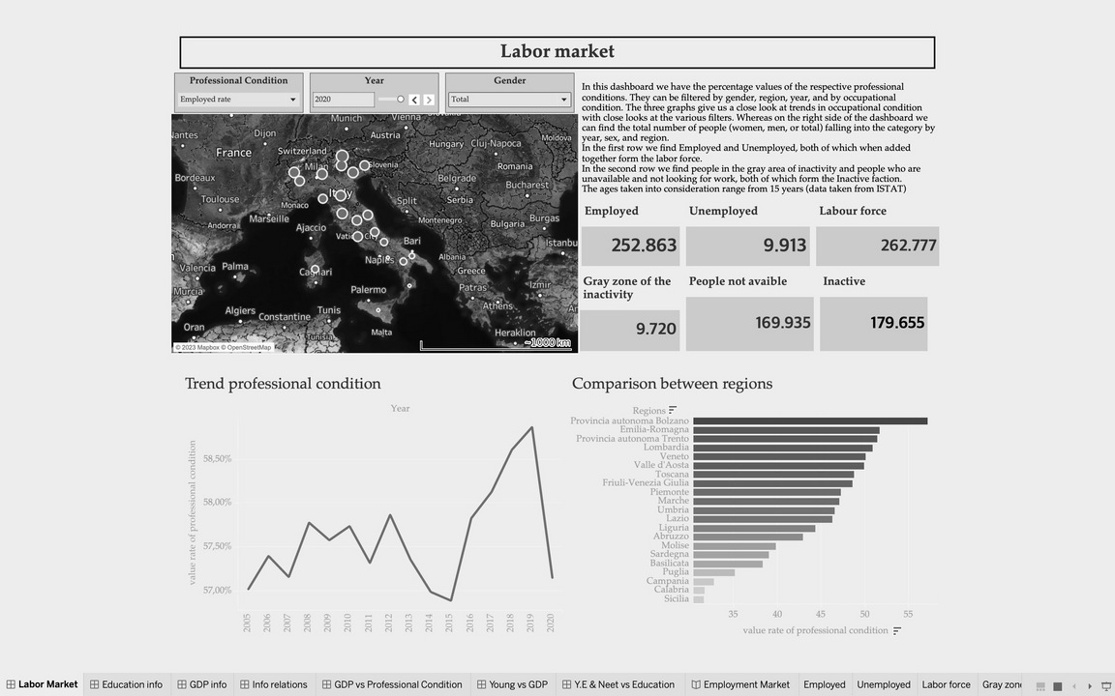
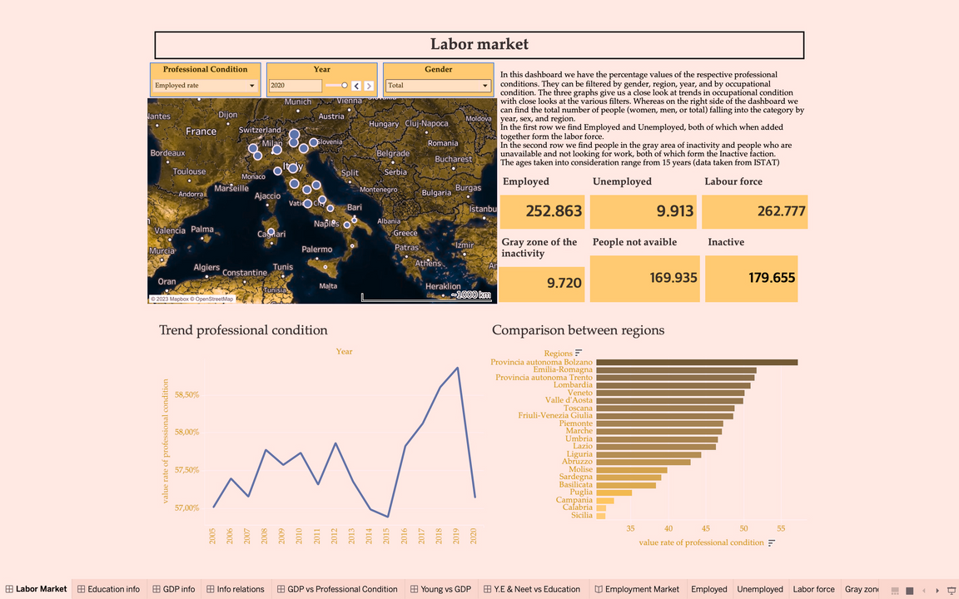
COLOR BLIND TEST
The Color Blind Test is a useful tool for testing whether the colors chosen for the dashboards can be seen by all kinds of people, even color-blind people.
BLACK AND WHITE TEST
DEUTAN TEST
This test is a basic test used for people who cannot distinguish between black and white. People with color blindness may have difficulty distinguishing between certain shades of gray.
The Deutan test is designed for those with deuteranopia, a type of red-green color blindness. Those people have difficulty distinguishing between red and green colors.

Slide 58
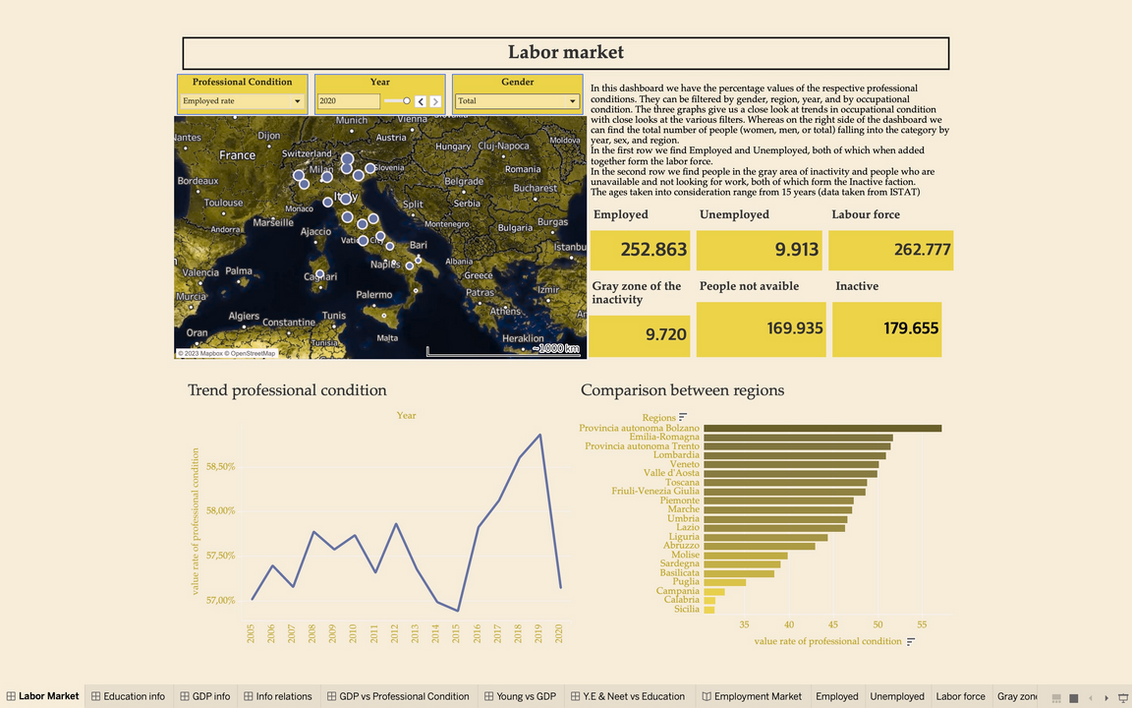
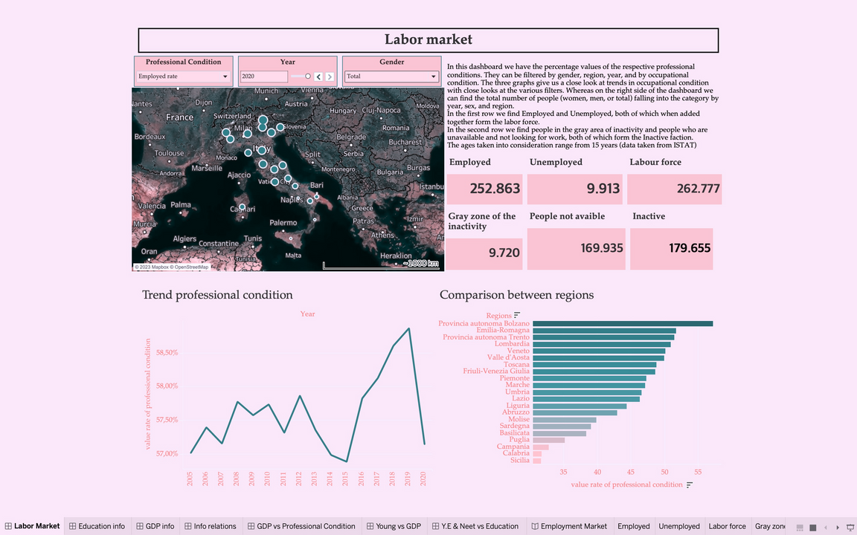
COLOR BLIND TEST
PROTAN TEST
TRITAN TEST
The Protan test is designed for those with Protanopia, another type of red-green color blindness. Those people have a deficiency in perceiving red colors. Those people may confuse reds with greens or see them differently from individuals with normal color vision.
The Tritan test is designed for those with Tritanopia, which is a rare form of color blindness affecting the blue-yellow color spectrum. Those people have difficulty distinguishing between blue and yellow colors.

Slide 59

Conclusion
In conclusion, we can say that the employment situation in Italy has suffered in the periods of the great crisis since the one in 2008, and despite some recoveries, the total employment rate has never regained its previous values.
The lowest peak was reached around 2014 with a slight recovery in the following years before declining again before the new pandemic crisis in 2020.
There is a turn-around in women's employment, which is a growing trend unlike men's employment, which grows slowly and is more affected by market conditions. But despite this, female employment is still lower in terms of absolute value.
Regarding the employment rate among regions, Sicily emerges as one of the regions with the lowest and highest employment values for unemployment.
Relative to youth employment, it continues to be a negative trend, especially in the central and southern regions. A small window opens in northern Italy, which in any case, is unable to absorb the entire youth supply of the peninsula, thus confirming that Italy tends to be a country for old people.

Slide 60
Thank you
for your attention!

